Slide 1
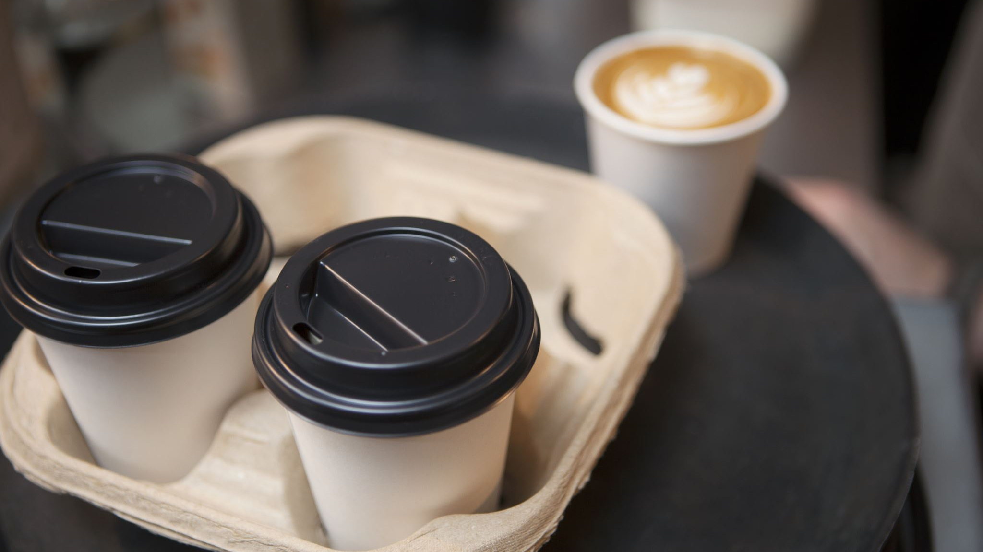
Lisbon’s Restaurants
Data Insights from Zomato

Slide 2
The unbalancing dilemma

